Slide 1
TEAM?OIES Online International EVAR System (ANONYMIZED Long Term Follow up EVAR Database) PRESENTATION Spring 2015
TEAM5OIES will allow doctors and researchers around the world to share data and analysis about endovascular aneurism repair (EVAR) patients. Specifically the CT scans and the results of simulations ran on the scans to identify indicators of serious long term complications with the newer less invasive method versus the older more invasive method. This will allow doctors to recommend the older method when a patient is at risk for long term complications with the newer method.
Team leader : Obinna Ugwuzor
DBAs: Jessica Balanag Kenny Loveall
SQAs: Eddie Guevara Shah Zaib
TMs: Michelle George Ryan Hornik Joe Lu Hector Reyna

Slide 2
TEAM?OIES Online International EVAR System (ANONYMIZED Long Term Follow up EVAR Database) BACKEND

Slide 3
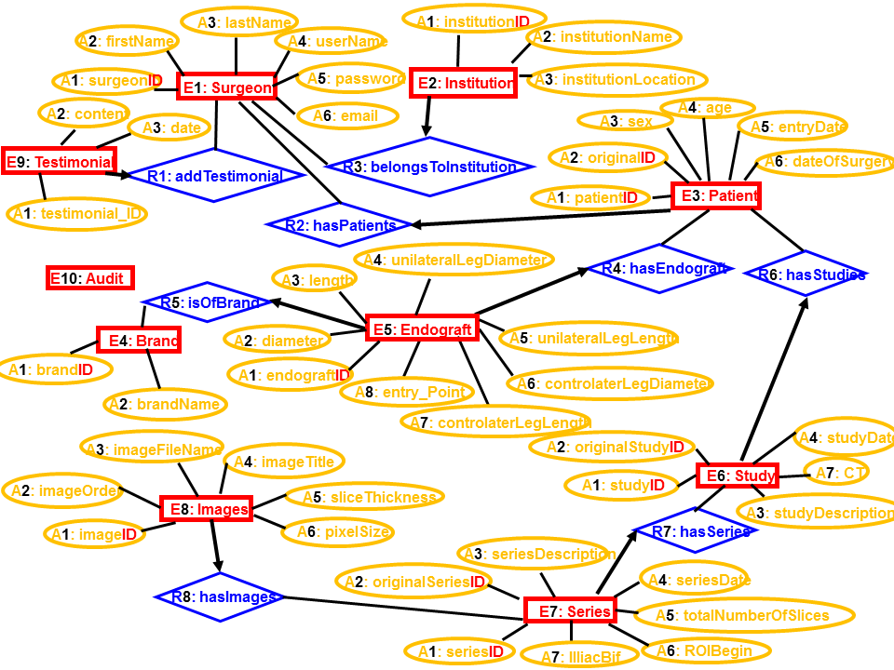
TEAM?OIES Online International EVAR System (ANONYMIZED Long Term Follow up EVAR Database) Data Analysis – ERD Model
10 E’s
8 R’s
48 A’s

Slide 4
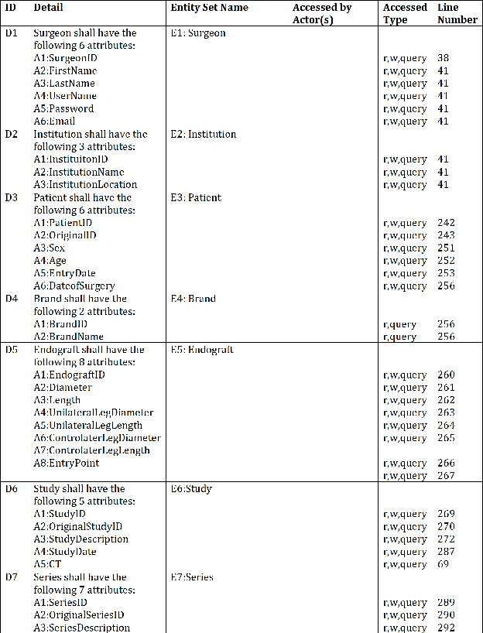
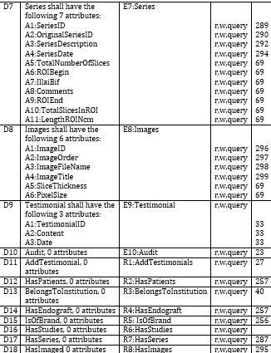
TEAM?OIES Online International EVAR System (ANONYMIZED Long Term Follow up EVAR Database) Contract – Data Requirements Specification
Data Requirements

Slide 5
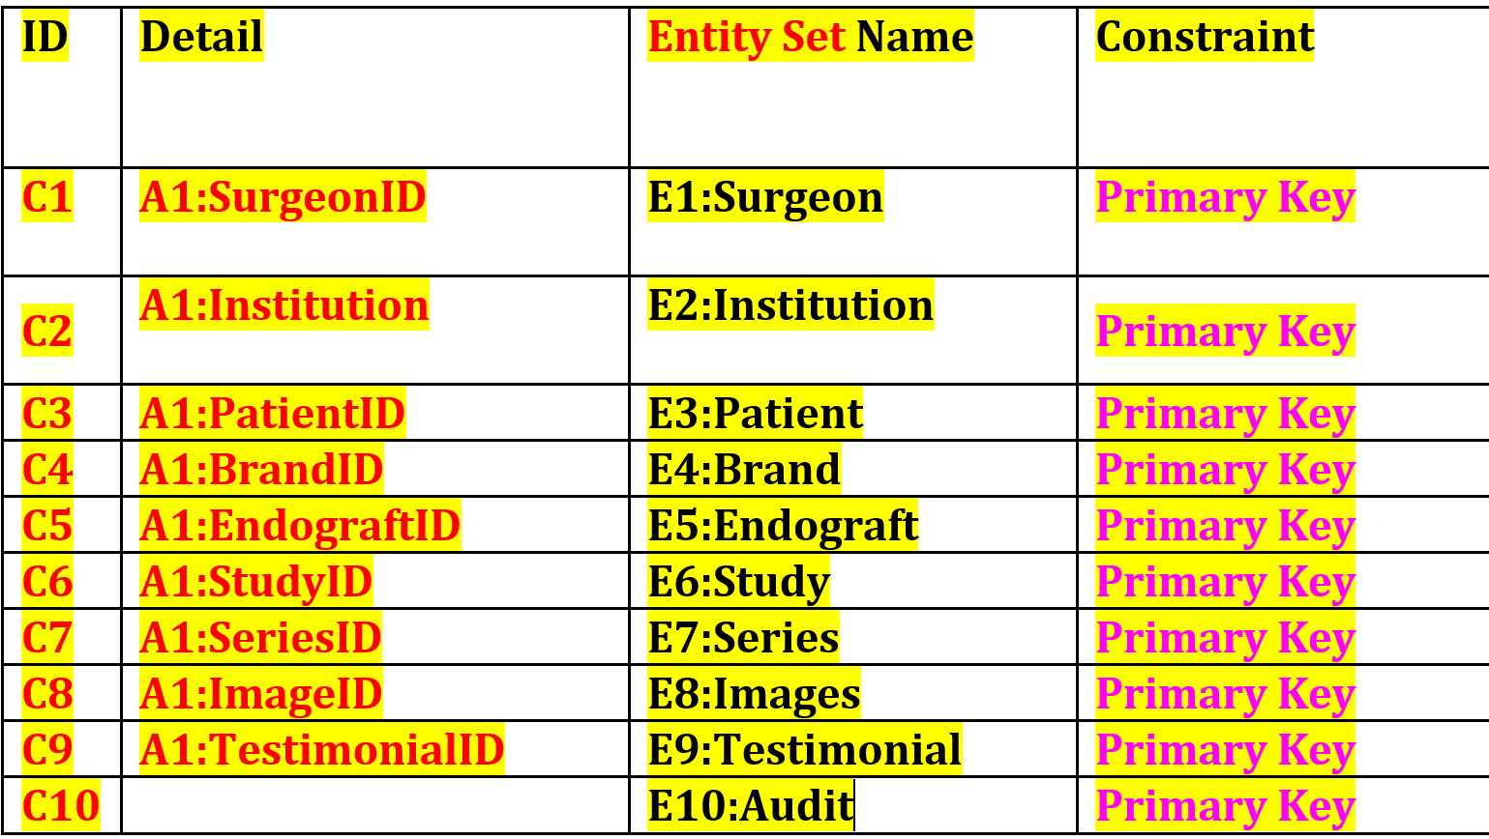
TEAM?OIES Online International EVAR System (ANONYMIZED Long Term Follow up EVAR Database) Contract – Data Requirements Specification
Constraints

Slide 6
TEAM?OIES Online International EVAR System (ANONYMIZED Long Term Follow up EVAR Database) Data Design – Relational Model
Surgeon
Institution
Patient
Testimonial
Audit
Endograft
Study
Brand
Image
Series

Slide 7
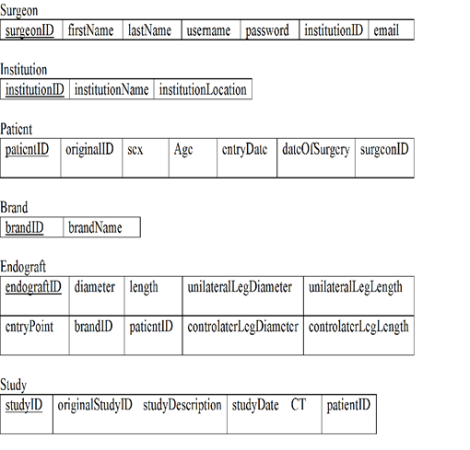
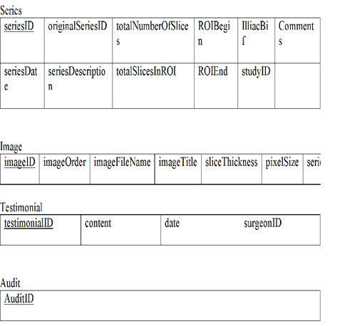
TEAM?OIES Online International EVAR System (ANONYMIZED Long Term Follow up EVAR Database) Data Design – Relational Model

Slide 8
TEAM?OIES Online International EVAR System (ANONYMIZED Long Term Follow up EVAR Database) FRONT END

Slide 9
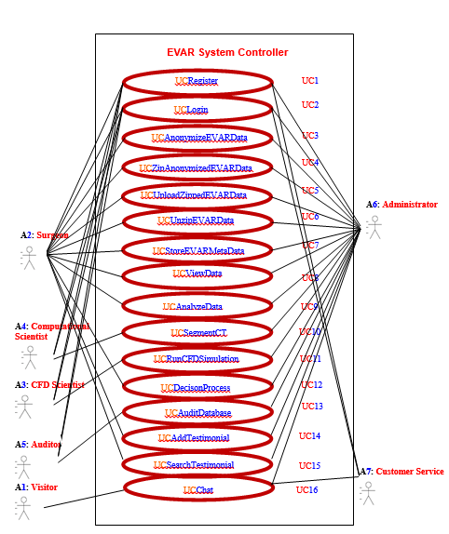
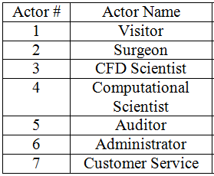
TEAM?OIES Online International EVAR System (ANONYMIZED Long Term Follow up EVAR Database) Business Modeling: UML USE CASE Model

Slide 10
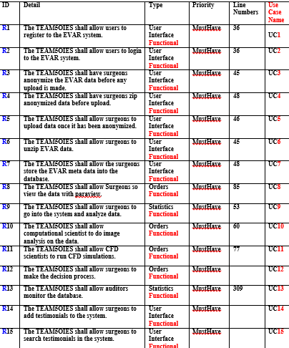
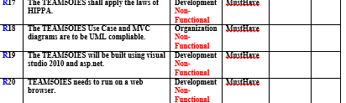
TEAM?OIES Online International EVAR System (ANONYMIZED Long Term Follow up EVAR Database) Contract: Software Requirements Specification
Functional Non-Functional

Slide 11
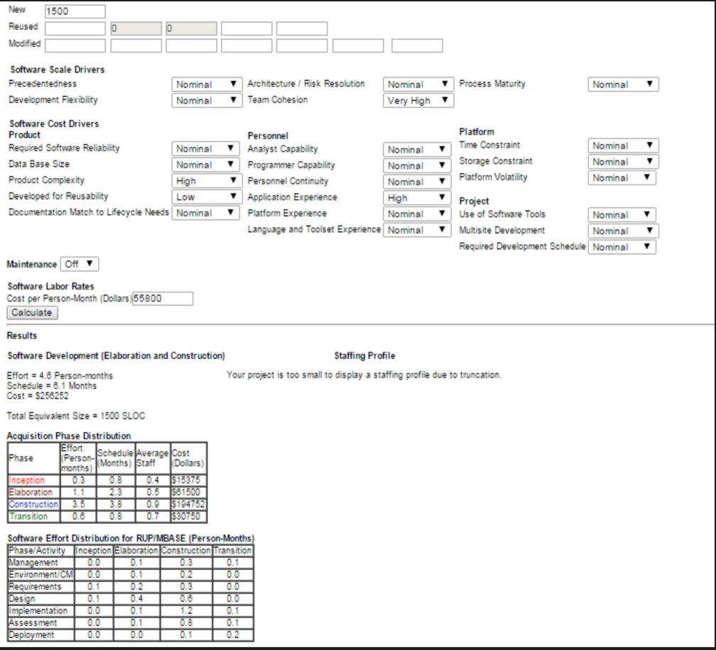
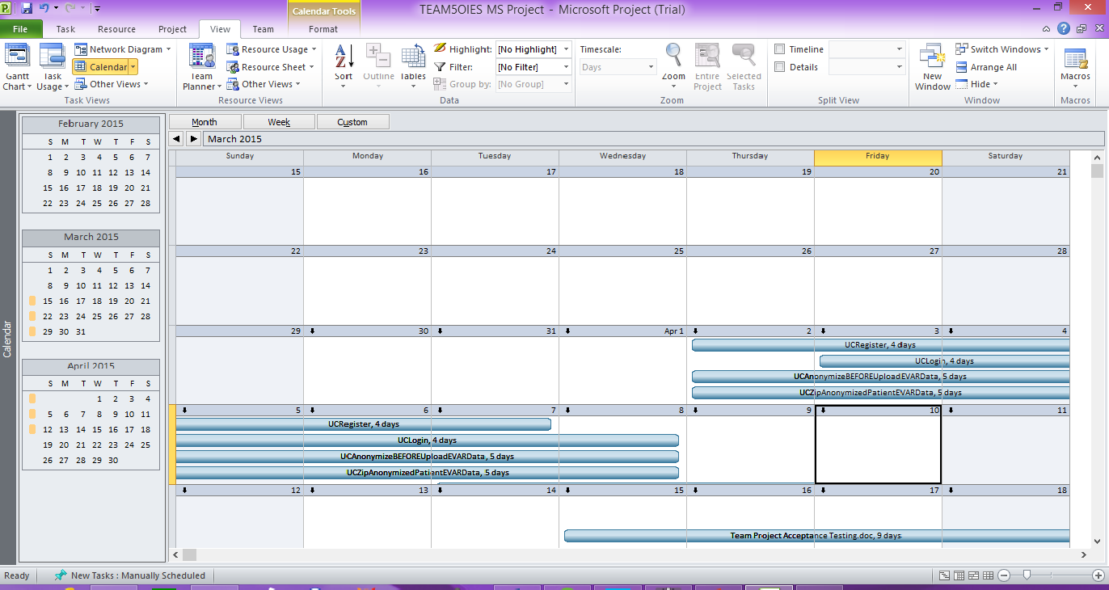
TEAM?OIES Online International EVAR System (ANONYMIZED Long Term Follow up EVAR Database) Software Project Management Plan
Estimated LOC: 1500 April 1 – 29 UC’s split amongst members of team
Estimated Cost: $256,252

Slide 12
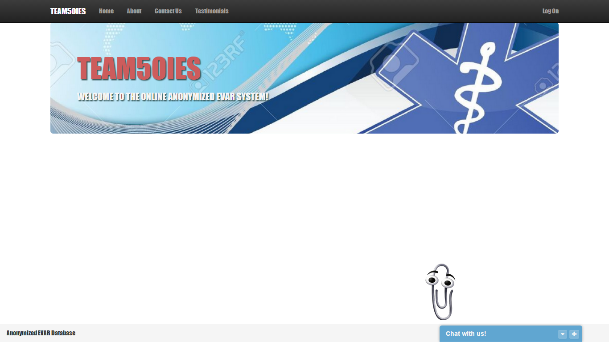
TEAM?OIES Online International EVAR System (ANONYMIZED Long Term Follow up EVAR Database) Web Site
Go to Website

Slide 13

TEAM?OIES Online International EVAR System (ANONYMIZED Long Term Follow up EVAR Database) Chat Demo
Go To Demo

